Slide 1

Rumour Detection System
AI + Source Transparency
Presented By: Abhishek , Km. Neha and Vishu Katariya
Course: M.Sc. IT (IV Semester)
College : MOTHERHOOD UNIVERSITY
Guided By: Dipanshu Sharma sir
Date: 02nd May 2026
Session: 2025-2026

Slide 2
Introduction
Rumour Detection System (RDS) is an AI-based system that analyzes text, headlines, or URLs to identify rumour and misleading or fake content, and provides results based on evidence and data sources.
It helps users:
Understand hidden meaning in text
Detect fake or misleading rumour content
Improve content reliability

Slide 3
Technology used
User Interface: Streamlit application
Language: Python
Text Processing: NLP (Natural Language Processing)
Machine learning: TF-IDF(Term Frequency–Inverse Document Frequency) and Logistic Regression
Dataset: Text and News dataset

Slide 4
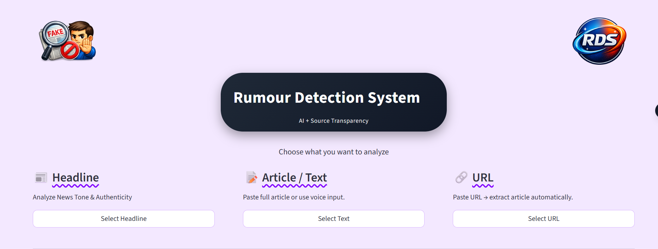
Interface of rDS

Slide 5
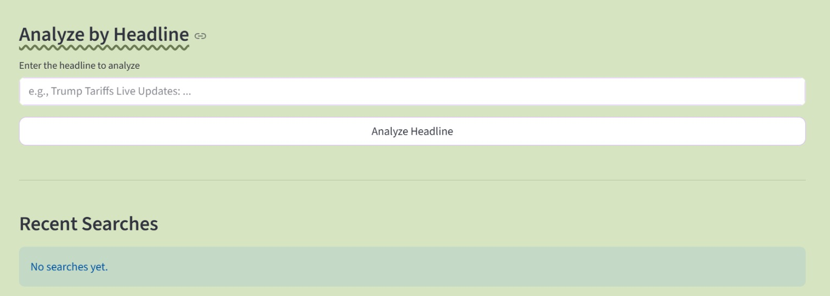

Slide 6
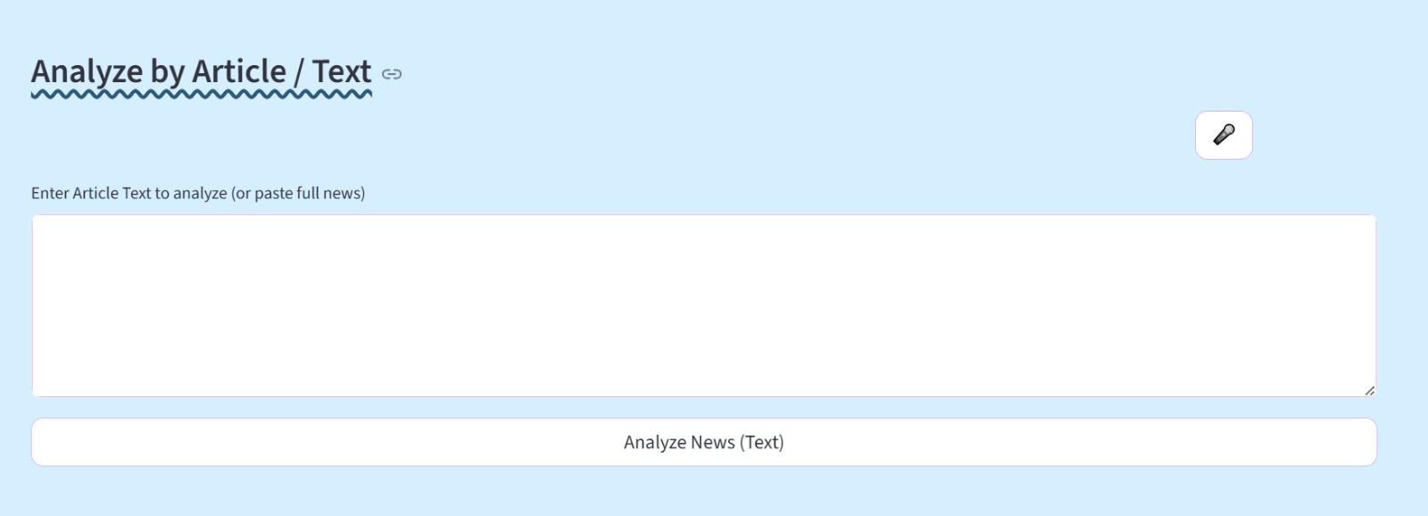

Slide 7
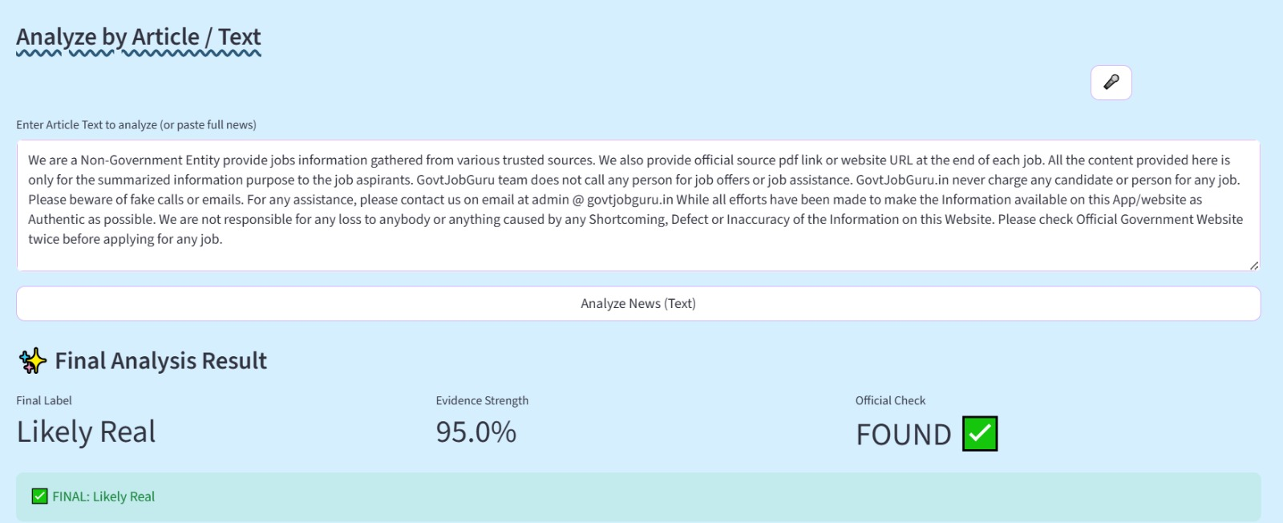

Slide 8
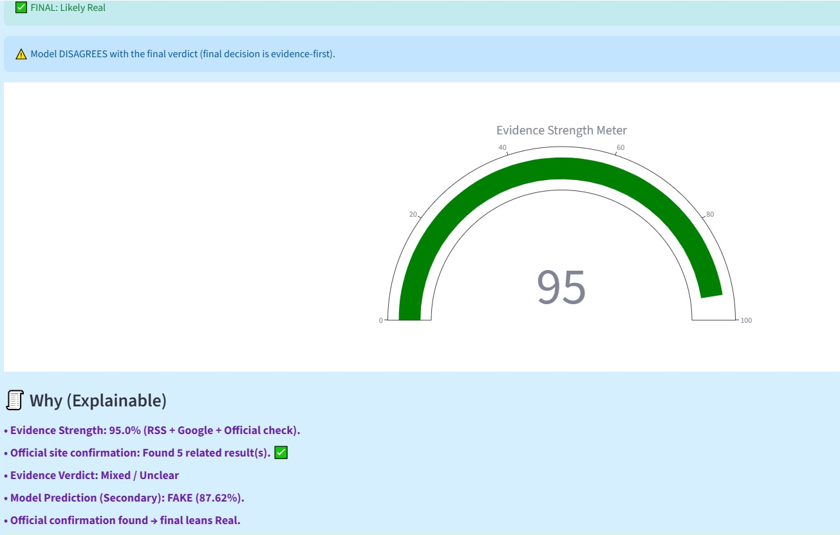
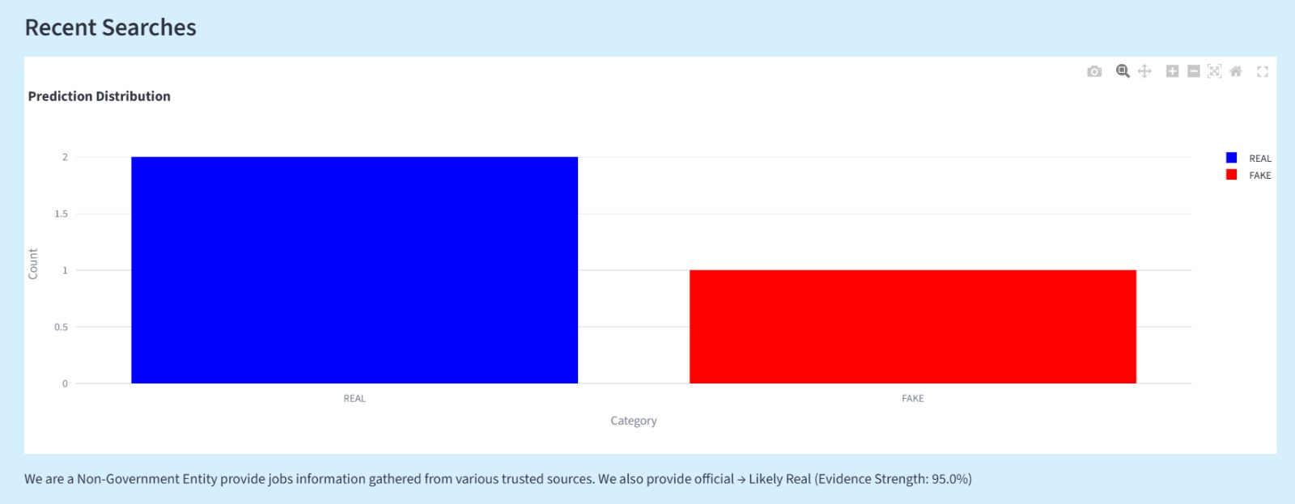
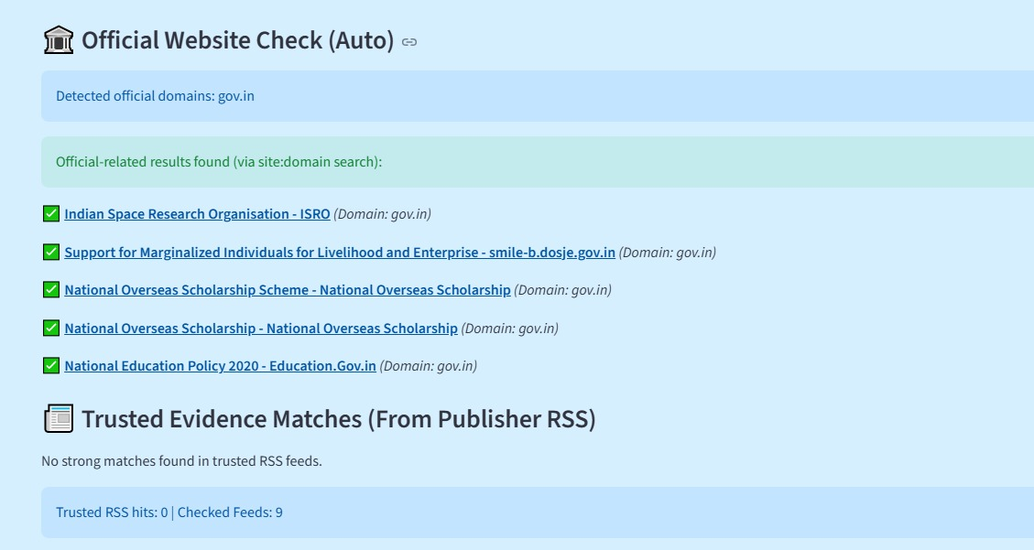

Slide 9
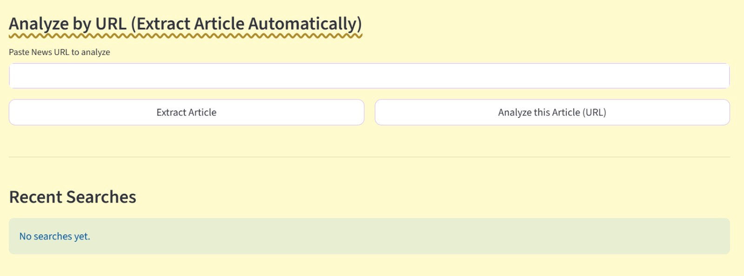

Slide 10
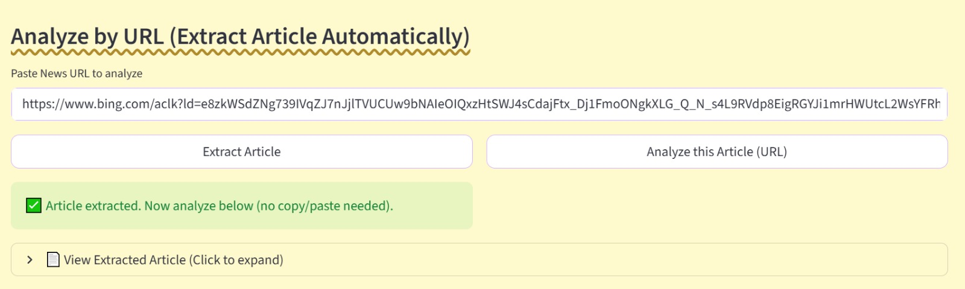

Slide 11
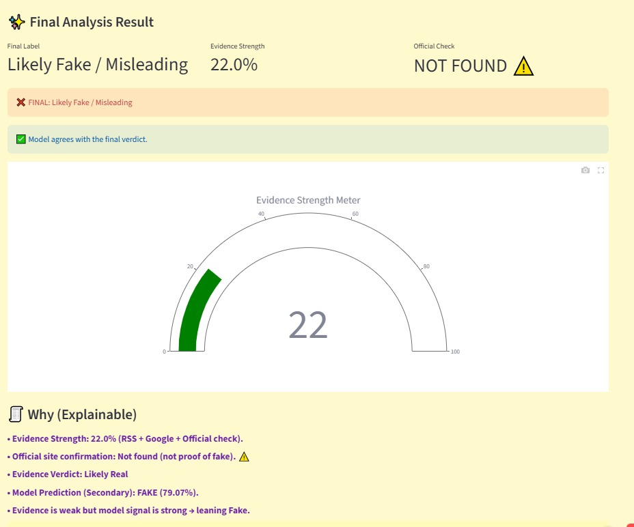
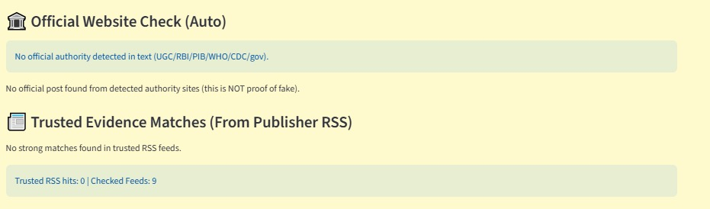
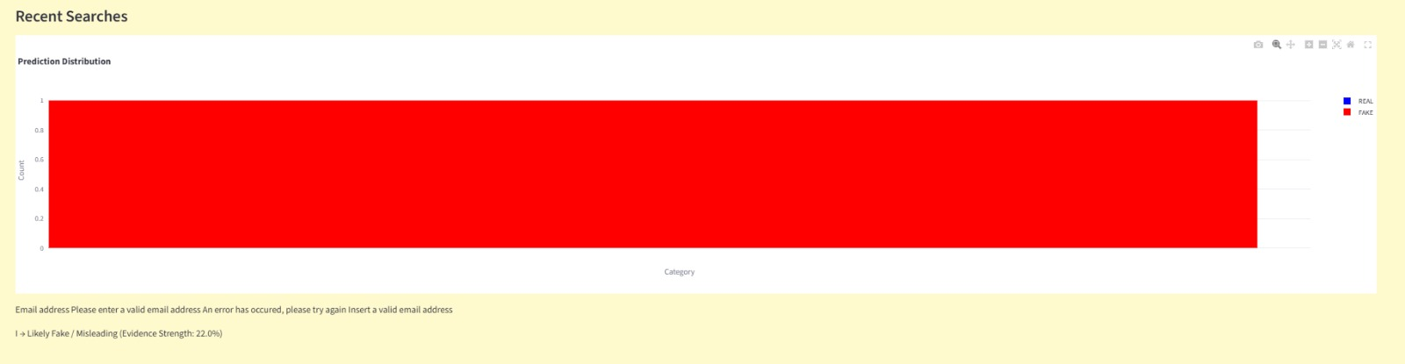

Slide 12
Features of rds
Analyzes text, headlines, and URLs
Performs AI-based text analysis
Supports evidence and source transparency
Identifies Rumour, sarcastic, or misleading patterns
Provides user-friendly and fast output

Slide 13
conclusion
RDS helps users analyze rumours, sarcastic, and misleading content in digital platforms.
It enhances user awareness and promotes better understanding of social media content.
The system is beneficial for students, researchers, and everyday users.

Slide 14
Thankyou

